Slide 1
High and Low Volume Samplers
Lapel Air Samplers
ACADs (08-006) Covered
Keywords
Suspended particulate matter, pollutants, SO₂, NO_{x}, CI₂, H₂S, NH₃, lapel.
Description
Supporting Material
3.2.4.5.2 | 3.2.4.5.3 | 3.2.5.4.4

Slide 2
High Volume Samplers
Principles of operation:
Measurement of SPM:
Air at a high flow rate of 1.1 to 1.7 CPM
high efficiency filter paper
Volume of air is measured by instrument
Amount of particles:
Change in weight of the filter paper
Suspended Particulate Matter (SPM)
Notes:
Air-borne suspended particulates (SPM) are measured by passing air at a high flow-rate of 1.1 to 1.7 cubic meters per minute through a high efficiency filter paper which retains the particles.
The instrument measures the volume of air sampled, while the amount of particulates collected is determined by measuring the change in weight of the filter paper as a consequence of the sampling. The passage for air reaching the filter is designed to prevent heavier settleable dust particles from reaching the filter thus measuring the concentration of Suspended Particulate Matter (SPM) in atmospheric air.*
http://www.indiamart.com/vupkaran-pvtltd/high-volume-air-samplers.html retrieved on March 5, 2013

Slide 3
High Volume Samplers
Simultaneous sampling of gaseous pollutants:
Air is passed through suitable reagents
Specific gases are absorbed
Pollutants SO_{2,} NO_{x}, Cl₂, H₂S, CS₂, NH₃, etc. are analyzed to determine the concentration of specific pollutant
Notes:
In high volume sampler provisions have been made for simultaneous sampling of gaseous pollutants. Here the air is passed through suitable reagents that would absorb specific gases where gaseous pollutants like SO_{2,} NO_{x}, Cl₂, H₂S, CS₂, NH₃, etc. are analyzed subsequently by simple wet chemistry method to determine the concentration of specific pollutant*
*http://www.indiamart.com/vupkaran-pvtltd/high-volume-air-samplers.html retrieved on March 5, 2013

Slide 4
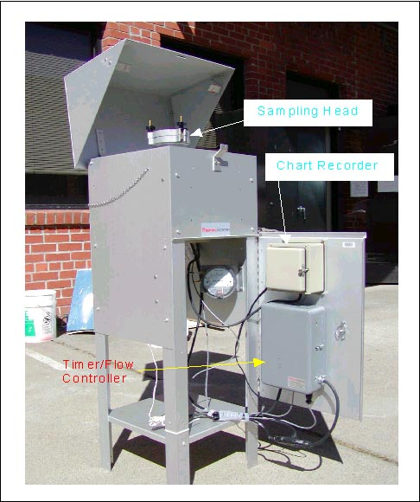
California Environmental Protection Agency High Volume Sampler

Slide 5
Low Volume Sampler
Low-volume sampling is sampling ambient air at a flow rate of 1 cubic meter per hour.
LVS measures the concentration of suspended particulate
Particles analyzed with regard to dust components
Notes:
The Low Volume Sampler is used for measuring the concentration of suspended particulate, indoors and outdoors. The particles sampled on the filter can be gravimetrically evaluated and analyzed with regard to dust components.

Slide 6
Low Volume Sampler
Operation:
Air through the inlet of the pump
Flow rate is measured
Air flow through separator to outlet
Notes:
The air sample is drawn in through the inlet by a vacuum pump. The air flow rate is measured by an orifice plate installed between the filter and the vacuum pump. The air sample flows through a separator for the abrasive carbon dust of the pump vanes to the outlet at the bottom of the device.

Slide 7
Low Volume Sampler
3 inlets for
PM10,
PM 2.5
PM1.0
Flow rate: 1.0 m³/h
Sampling time: 1 hour and 999 h
Sample diameter: 47-50 mm
Notes:
The Low Volume Sampler has 3 inlets for PM10, PM 2.5 and PM1.0 measurements, flow rate of 1.0 m³/h, the sampling time could be between 1 hour and 999 h. The diameter for sample filter is 47-50 mm.
The suspension particles concentration can be determined using a relation between the filter mass before and after exposure and the total air volume drawn

Slide 8
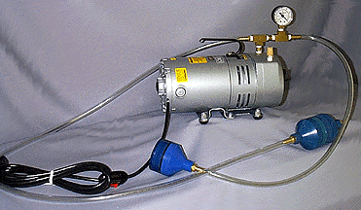
Low Volume Sampler
http://www.atnuke.com/nuclear/Airsampling/pump2.htm

Slide 9
Lapel Air Sample
LAS (personal air samplers)
Worn by a worker
Filter holder on/close to the shirt collar
Vacuum pump on the belt.
Best to estimate breathing zone concentrations

Slide 10
Lapel Air Sample
Disadvantages:
Low flow rate (2 L/min)
Can be contaminated by improper handling
Expensive
Uncomfortable to wear
Workers must be sure to turn them on and off.
With improvements LAS may become a sampling system of choice for determining intake

Slide 11
Lapel Air Sample
Failure due to:
Battery failure
Inadequate charging
Debris in the sample pump
Leakage caused by vibration
Fatigues in its valves or diaphragms
Mechanical failure of rotary vane pumps

Slide 12
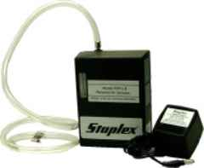
Personal Air Sampler
http://www.staplex.com/airsamplers/personal/personal.htm

